Slide 1
Programming Fundamentals
Lecture 02
Dr. Syed Aun Irtaza

Slide 2
Basic Program Construction
Let’s look at a very simple C++ program. It simply prints a sentence on the screen.
  #include <iostream>
  using namespace std;
  int main()
  {
  cout << “Every age has a language of its own\n”;
  return 0;
  }

Slide 3
Whitespace
C++ compiler ignores whitespace almost completely. Whitespace is defined as spaces, carriage returns, linefeeds, tabs, etc.
These characters are invisible to the compiler. You can put several statements on one line, separated by any number of spaces or tabs, or you can run a statement over two or more lines. It’s all the same to the compiler.

Slide 4
Whitespace
  #include <iostream>
  using
  namespace std;
  int main () { cout
  <<
  “Every age has a language of its own\n”
  ; return
  0;}
  But this syntax is not recommend—it’s nonstandard and hard to read—but it does compile correctly.

Slide 5
Whitespace: exceptions to the rule
Following are the exceptions to whitespaces in C++
  The first line of the program, starting with #include, is a preprocessor directive, which must be written on one line.
  Also, string constants, such as “Every age has a language of its own”, cannot be broken into separate lines.

Slide 6
Output Using cout
The identifier cout (pronounced “C out”) is actually an object.
It is predefined in C++ to correspond to the standard output stream. And a stream is an abstraction that refers to a flow of data.
The standard output stream normally flows to the screen display — although it can be redirected to other output devices.
The operator << is called the insertion or put to operator.

Slide 7
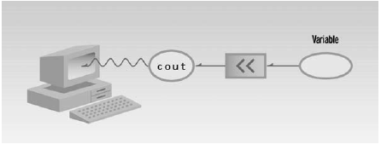
Output Using cout

Slide 8
String Constants
The phrase in quotation marks, “Every age has a language of its own\n”, is an example of a string constant.
A constant, unlike a variable, cannot be given a new value as the program runs. Its value is set when the program is written, and it retains this value throughout the program’s existence.

Slide 9
Directives
The two lines that begin the FIRST program are directives. The first is a preprocessor directive, and the second is a using directive.

Slide 10
Directives: Preprocessor Directives
#include <iostream>
It isn’t part of a function body and doesn’t end with a semicolon, as program statements must.
It’s called a preprocessor directive. A preprocessor directive, on the other hand, is an instruction to the compiler.
A part of the compiler called the preprocessor deals with these directives before it begins the real compilation process.

Slide 11
Directives: Preprocessor Directives
The preprocessor directive #include tells the compiler to insert another file into your source file.
In effect, the #include directive is replaced by the contents of the file indicated.
Using an #include directive to insert another file into your source file is similar to pasting a block of text into a document with your word processor.

Slide 12
Directives: Header Files
IOSTREAM is an example of a header file (sometimes called an include file).
It’s concerned with basic input/output operations, and contains declarations that are needed by the cout identifier and the << operator.
Without these declarations, the compiler won’t recognize cout and will think << is being used incorrectly.
There are many such include files. The newer Standard C++ header files don’t have a file extension, but some older header files, left over from the days of the C language, have the extension .H.

Slide 13
Directives: The using Directive
A C++ program can be divided into different namespaces.
A namespace is a part of the program in which certain names are recognized; outside of the namespace they’re unknown.
The directive using namespace std says that all the program statements that follow are within the std namespace.

Slide 14
Directives: The using Directive
If we didn’t use the using directive, we would need to add the std name to many program elements. For example, in the FIRST program we’d need to say
std::cout << “Every age has a language of its own.”;

Slide 15
Comments
Comments are an important part of any program. They help the person writing a program, and anyone else who must read the source file, understand what’s going on.
The compiler ignores comments, so they do not add to the file size or execution time of the executable program.
Comments start with a double slash symbol (//) and terminate at the end of the line.
A comment can start at the beginning of the line or on the same line following a program statement.

Slide 16
Comments
COMMENTS an example
// this prog demonstrates comments
#include <iostream> // preprocessor directive
using namespace std; // using directive
int main() //function name “main”
{ //start function body
cout << “Every age has a language of its own\n”;
return 0;
} //end function body

Slide 17
Comments: Alternative Syntax
There’s a second comment style available in C++
/* this is an old-style comment */
A programmer can write a multiline comment with only two comment symbols
/* this
is a
potentially
very long
multiline
comment
*/

Slide 18
Special Symbols
The smallest individual unit of a program written in any language is called a token.
C++’s tokens are divided into special symbols, keyword symbols, and identifiers.

Slide 19

Special Symbols
Following are some of the special symbols:
Note that a blank, which is not shown above, is also a special symbol. You can create a blank symbol by pressing the space bar (only once) on the keyboard.

Slide 20
Reserved Words (Keywords)
Keyword symbols cannot be redefined within any program; that is, they cannot be used for anything other than their intended use
Some of the word symbols include the following:
int, float, double, char, const, void, return
Reserved words are also called keywords. The letters that make up a reserved word are always lowercase.

Slide 21
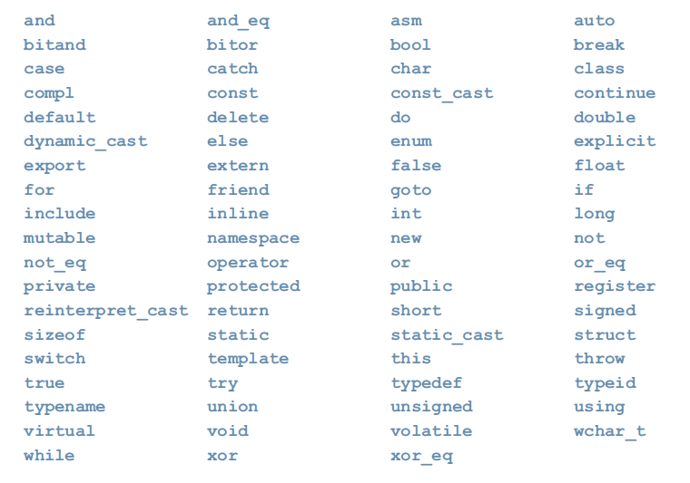
Reserved Words (Keywords)

Slide 22
Identifier/variables
Identifiers are names of things that appear in programs, such as variables, constants, and functions.
All identifiers must obey C++’s rules for identifiers.
A C++ identifier consists of letters, digits, and the underscore character ( _ ) and must begin with a letter or underscore.

Slide 23
Rules For Naming Variables
Variable names must begin with a letter.
Variable names can contain letters, numbers and the underscore.
Variable names CANNOT CONTAIN SPACES
Variable names must be less than 255 characters
Variable name cannot be a reserved word
Variable names CANNOT CONTAIN Special Chracters

Slide 24
Rules For Naming Variables
C++ is case sensitive—uppercase and lowercase letters are considered different.
Thus, the identifier NUMBER is not the same as the identifier number.
Similarly, the identifiers X and x are different.

Slide 25
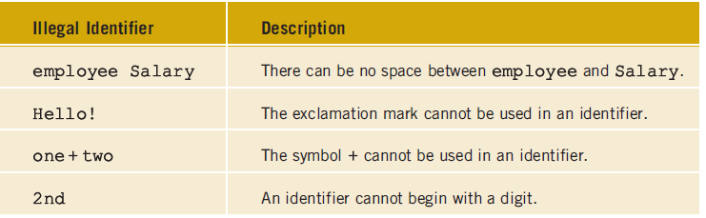
Rules For Naming Variables

Slide 26
DATA Type: Integer
Variables are the most fundamental part of any language. A variable has a symbolic name and can be given a variety of values.
Variables are located in particular places in the computer’s memory.
Integer variables represent integer numbers like 1, 30,000, and –27.

Slide 27
Defining Integer Variables
Integer variables exist in several sizes, but the most commonly used is type int.
The amount of memory occupied by the integer types is system dependent. On a 32-bit system such as Windows, an int occupies 4 bytes (which is 32 bits) of memory.
This allows an int to hold numbers in the range from –2,147,483,648 to 2,147,483,647.
It occupied only 2 bytes in MS-DOS and earlier versions of Windows.

Slide 28
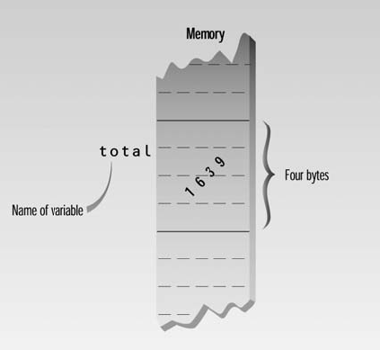
Defining Integer Variables

Slide 29
Declarations and Initialization
To declare a variable you must supply a valid variable name, a datatype and a semicolon.
You may also assign a value at this time, this is called initialization.

Slide 30
Declarations and Initialization
#include <iostream>
using namespace std;
int main()
{
int var1; //define var1
int var2; //define var2
var1 = 20; //assign value to var1
var2 = var1 + 10; //assign value to var2
cout << “var1+10 is “; //output text
cout << var2 << endl; //output value of var2
return 0;
}

Slide 31
Other Integer Types
int | 4bytes | -2147483648 to 2147483647
unsigned int | 4bytes | 0 to 4294967295
short int | 2bytes | -32768 to 32767
unsigned short int | Range | 0 to 65,535
signed short int | Range | -32768 to 32767
long int | 4bytes | -2,147,483,647 to 2,147,483,647
signed long int | 4bytes | same as long int
unsigned long int | 4bytes | 0 to 4,294,967,295

Slide 32
DATA Type: Floating Point
Floating-point variables represent numbers with a decimal place—like 3.1415927, 0.0000625, and –10.2.
They have both an integer part, to the left of the decimal point, and a fractional part, to the right.
Floating-point variables represent what mathematicians call real numbers, which are used for measurable quantities such as distance, area, and temperature.

Slide 33
DATA Type: Floating Point
There are three kinds of floating-point variables in C++
  Float
  Double
  Long double

Slide 34
Floating Point Types: float
Type float stores numbers in the range of about
3.4x10^{–38} to 3.4x10⁺³⁸
Float numbers with a precision of seven digits.
It occupies 4 bytes (32 bits) in memory

Slide 35
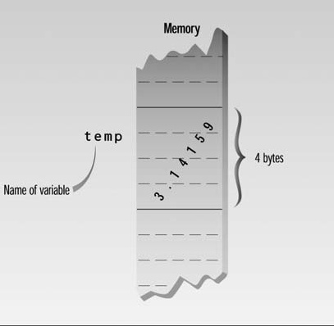
Floating Point Types: float

Slide 36
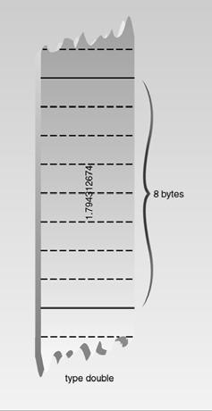
Floating Point Types: double
The data type double is used in C++ to represent any real number between -1.7E+308 and 1.7E+308. It can also be represented as follow
1.7x10^{–308} to 1.7x10³⁰⁸.
The memory allocated for a value of the double data type is eight bytes.

Slide 37
Floating Point Types: long double
Type long double is compiler-dependent but is often the same as double.
It means long double can store value between
1.7x10^{–308} to 1.7x10³⁰⁸.

Slide 38
Floating Point Constant
To represent a floating-point constant letter ‘F’ is appended at the end of number which specifies that it’s type float, rather than double or long double.
float PI = 3.14159F;
You don’t need a suffix letter with constants of type double. It’s the default.
With type long double, use the letter L.
long double large_number = 42343.12342344159L;

Slide 39
DATA Type : Bool
The data type bool has only two values: true and false.
The central purpose of this data type is to manipulate logical (Boolean) expressions (we will discuss later during this course).
In C++, bool, true, and false are reserved words.

Slide 40
DATA Type : Bool
In theory a bool type requires only one bit (not byte) of storage, but in practice compilers often store them as bytes
Because a byte can be quickly accessed, while an individual bit must be extracted from a byte, which requires additional time.
Type bool gets its name from George Boole, a 19th century English mathematician who invented the concept of using logical operators with true-or-false values.

Slide 41
DATA Type : Character
It is mainly used to represent characters—that is, letters, digits, and special symbols.
Thus, the char data type can represent every key on your keyboard.
When using the char data type, you enclose each character represented within single quotation marks.
Examples of values belonging to the char data type include the following:
'A', 'a', '0', '*', '+', '$', '&', ' '

Slide 42
DATA Type : Character
Variables of this type occupy only 1 byte (eight bits) of memory.
When the C++ compiler encounters such a character constant, it translates it into the corresponding ASCII code.
For example, the value representing 'B' is 66, so 'A' is smaller than 'B'. Similarly, '+' is smaller than 'A' because 43 is smaller than 65.

Slide 43
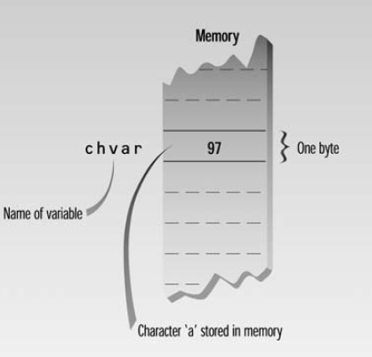
DATA Type : Character
The constant ‘a’ appearing in a program, for example, will be translated into 97

Slide 44
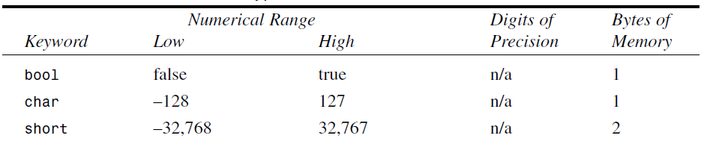
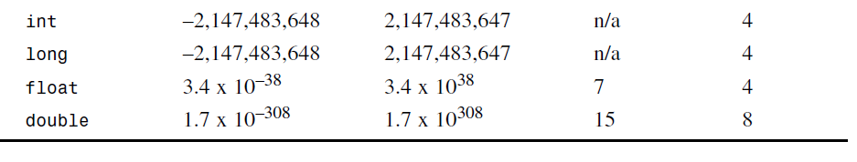
Variable Type Summary

Slide 45
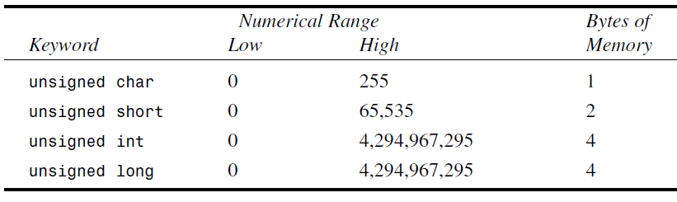
Variable Type Summary

Slide 46
Escape Sequences
The name reflects the fact that the backslash causes an “escape” from the normal way characters are interpreted
Escape sequences can be used as separate characters or embedded in string constants.
For example
  ‘\n’ new line
  ‘\t’ Tab

Slide 47
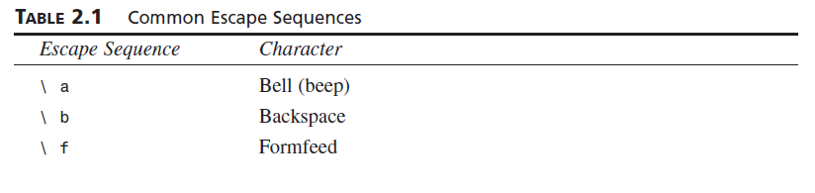
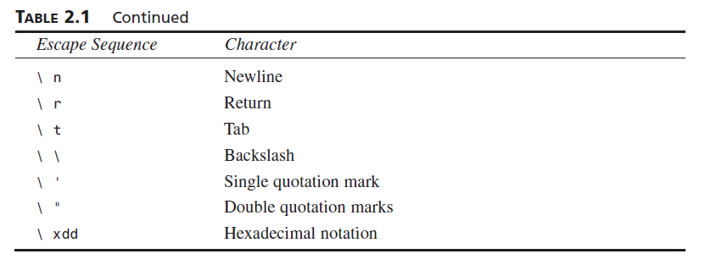
Escape Sequences

Slide 48
Use of Character Variables and Escape Sequences
int main()
{
char charvar1 = ‘A’; //define char variable as character
char charvar2 = ‘\t’; //define char variable as tab
cout << charvar1; //display character
cout << charvar2; //display character
charvar1 = ‘B’; //set char variable to char constant
cout << charvar1; //display character
cout << ‘\n’; //display newline character
return 0;
}

Slide 49
Arithmetic Operators
You can use the standard arithmetic operators to manipulate integral and floating-point data types. There are five arithmetic operators
+ addition
- subtraction or negation
* multiplication
/ division
% mod, (modulus or remainder)

Slide 50
Expressions
Any arrangement of variables, constants, and operators that specifies a computation is called an expression.
Examples of expression are
  alpha+12
  (alpha-37)*beta/2
Parts of expressions may also be expressions. In the second example, alpha-37 and beta/2 are expressions.
Even single variables and constants, like alpha and 37, are considered to be expressions.

Slide 51
Expressions
Note that expressions aren’t the same as statements.
Statements tell the compiler to do something and terminate with a semicolon, while expressions specify a computation.
There can be several expressions in a statement.

Slide 52
Expressions
operands
x + 2 *5 + 6 / y
operators

Slide 53
Expressions
Unary operator: An operator that has only one operand.
(-5)+7
Binary operator: An operator that has two operands.
2 + 3 *5

Slide 54
Expressions
int main()
{
  cout << "2 + 5 = " << 2 + 5 << endl;
  cout << "13 + 89 = " << 13 + 89 << endl;
  cout << "34 - 20 = " << 34 - 20 << endl;
  cout << "45 - 90 = " << 45 - 90 << endl;
  cout << "2 * 7 = " << 2 * 7 << endl;
  cout << "5 / 2 = " << 5 / 2 << endl;
  cout << "14 / 7 = " << 14 / 7 << endl;
  cout << "34 % 5 = " << 34 % 5 << endl;
  cout << "4 % 6 = " << 4 % 6 << endl;
  return 0;
}

Slide 55
Expressions
int main()
{
  cout << "2 + 5 = " << 2 + 5 << endl; 2 + 5 = 7
  cout << "13 + 89 = " << 13 + 89 << endl; 13 + 89 = 102
  cout << "34 - 20 = " << 34 - 20 << endl; 34 - 20 = 14
  cout << "45 - 90 = " << 45 - 90 << endl; 45 - 90 = -45
  cout << "2 * 7 = " << 2 * 7 << endl; 2 * 7 = 14
  cout << "5 / 2 = " << 5 / 2 << endl; 5 / 2 = 2
  cout << "14 / 7 = " << 14 / 7 << endl; 14 / 7 = 2
  cout << "34 % 5 = " << 34 % 5 << endl; 34 % 5 = 4
  cout << "4 % 6 = " << 4 % 6 << endl; 4 % 6 = 4
  return 0;
}

Slide 56
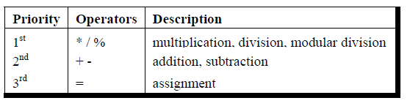
Arithmetic Operators: precedence

Slide 57

Arithmetic Operators: precedence
3 * 7 - 6 + 2 * 5 / 4 + 6

Slide 58
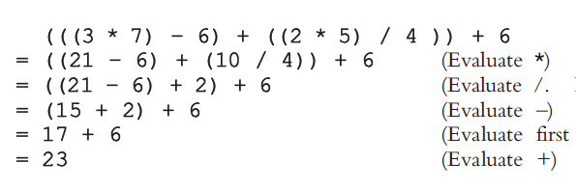
Arithmetic Operators: precedence
3 * 7 - 6 + 2 * 5 / 4 + 6

Slide 59
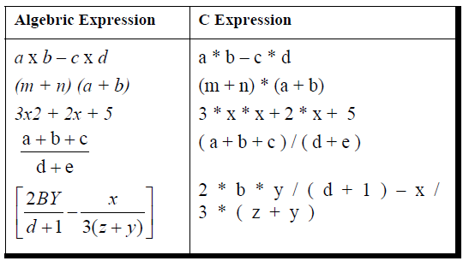
Arithmetic Operators: precedence

Slide 60
Type Conversion
C++, like C, is more forgiving than some languages in the way it treats expressions involving several different data types. As an example, consider the following program
  int main()
  {
  int count = 7;
  float avgWeight = 155.5F;
  double totalWeight = count * avgWeight;
  cout << “totalWeight=” << totalWeight << endl;
  return 0;
  }
Here a variable of type int is multiplied by a variable of type float to yield a result of type double.

Slide 61
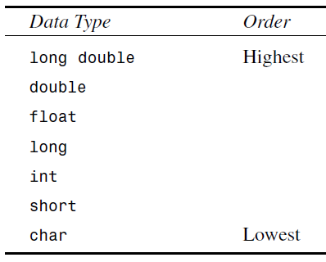
Automatic Conversions
When two operands of different types are encountered in the same expression, the lower-type variable is converted to the type of the higher-type variable.
double totalWeight = count * avgWeight;
the int value of count is converted to type float and stored in a temporary variable before being multiplied by the float variable avgWeight.

Slide 62
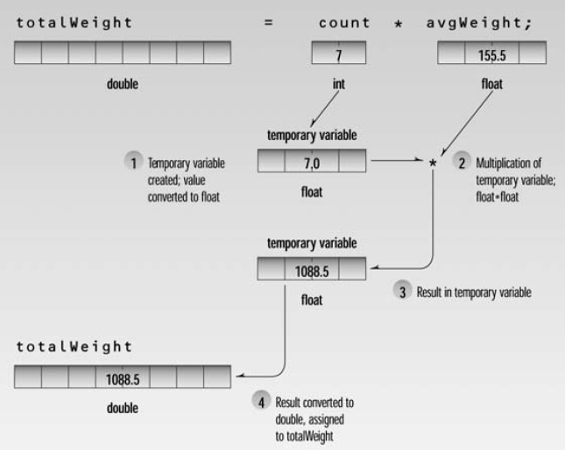
Automatic Conversions

Slide 63

Mixed Expression

Slide 64
Mixed Expression

Slide 65
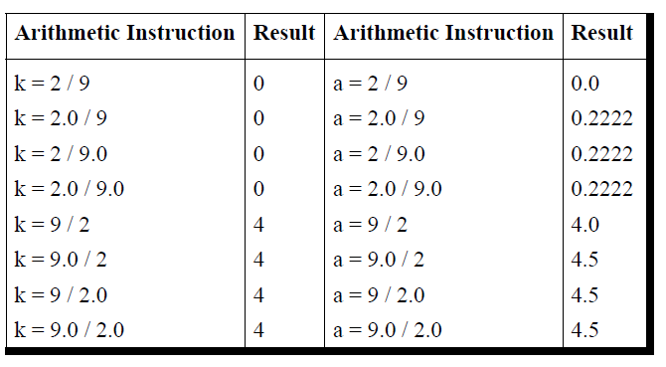
Mixed Expression

Slide 66
Assignment Statements
The statements
  var1 = 20;
  var2 = var1 + 10;
Assign values to the two variables. The equal sign (=), as you might guess, causes the value on the right to be assigned to the variable on the left.
In the first line shown here, var1, which previously had no value, is given the value 20.

Slide 67
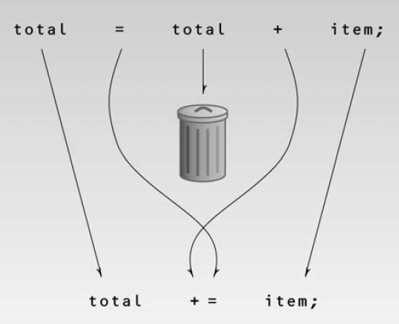
Assignment Statements

Slide 68
Assignment Statements
There are arithmetic assignment operators corresponding to all the arithmetic operations:
+=,
-=
*=
/=
%=

Slide 69
Increment Operators
You often need to add 1 to the value of an existing variable. You can do this the “normal” way:
count = count + 1;
Or you can use an arithmetic assignment operator:
count += 1;
But there’s an even more condensed approach:
++count

Slide 70
Increment Operators: Prefix and Postfix
The increment operator can be used in two ways as
Prefix: meaning that the operator precedes the variable.
Postfix, meaning that the operator follows the variable.
What’s the difference?

Slide 71
Increment Operators: Prefix and Postfix
What’s the difference? Lets have an example
  int main(){
  int avgWeight = 5, count = 10, totalWeight = 0;
  totalWeight = avgWeight * ++count;
  cout << “totalWeight =“<<totalWeight<<endl;
  cout << “avgWeight =“<< avgWeight<<endl;
  cout << “count =“<< count<<endl;
  return 0;
  }

Slide 72
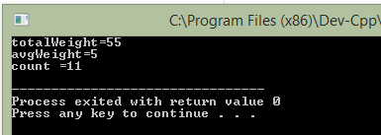
Increment Operators: Prefix and Postfix
What’s the difference? Lets have an example
  int main(){
  int avgWeight = 5, count = 10, totalWeight = 0;
  totalWeight = avgWeight * ++count;
  cout << “totalWeight =“<<totalWeight<<endl;
  cout << “avgWeight =“<< avgWeight<<endl;
  cout << “count =“<< count<<endl;
  return 0;
  }

Slide 73
Increment Operators: Prefix and Postfix
What’s the difference? Lets have an example
  int main(){
  int avgWeight = 5, count = 10, totalWeight = 0;
  totalWeight = avgWeight * count++;
  cout << “totalWeight =“<<totalWeight<<endl;
  cout << “avgWeight =“<< avgWeight<<endl;
  cout << “count =“<< count<<endl;
  return 0;
  }

Slide 74
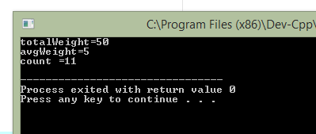
Increment Operators: Prefix and Postfix
What’s the difference? Lets have an example
  int main(){
  int avgWeight = 5, count = 10, totalWeight = 0;
  totalWeight = avgWeight * count++;
  cout << “totalWeight =“<<totalWeight<<endl;
  cout << “avgWeight =“<< avgWeight<<endl;
  cout << “count =“<< count<<endl;
  return 0;
  }

Slide 75
The Decrement (--) Operator
The decrement operator, --, behaves very much like the increment operator, except that it subtracts 1 from its operand.
It too can be used in both prefix and postfix forms.
count --; and --count;

Slide 76
You are enough capable to write
The total time for work (in minutes) and rate per hour is input through the keyboard. Write a program to calculate and print total pay.

Slide 77
Input using Cin
  int main(){
  int timeinmin, totalpay=0, rateperhr;
  float timeinhr;
  cout << “Enter total minutes you worked”;
  cin>>timeinmin;
  cout << “Enter rate per hour”;
  cin>>rateperhr;
  timeinhour = timeinmin/60;
  totalpay = timeinhour * rateperhr;
  cout << “Your Total Pay =”<< totalpay <<endl;
  return 0;
  }

